Slide 1
Supermarket Tracker

Slide 2
About
Many of us have wanted to know the opening times for a supermarket, or find the nearest supermarket to us, having to search online or look around on Google Maps, which is time consuming and therefore the aim of the group project is to create an app that displays all supermarkets and their opening times within a selected range, the user may then be used to navigate to said store.

Slide 3
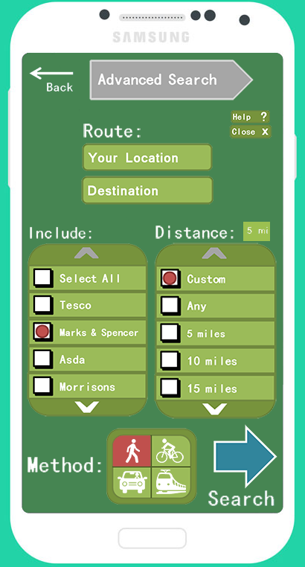
Searching
When the app is used, there are two options in which the user may use to search. Firstly, by entering your destination and choosing your method of travel. Secondly, by using the advanced search option where you pick which supermarkets to include in the search and the radius in which it displays followed by the method of travel.

Slide 4
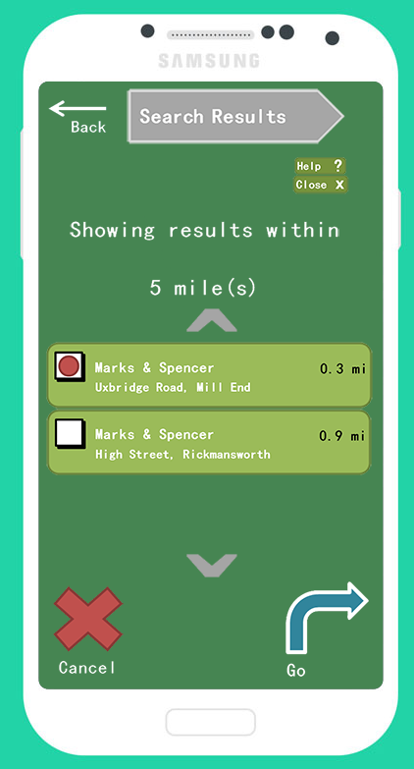
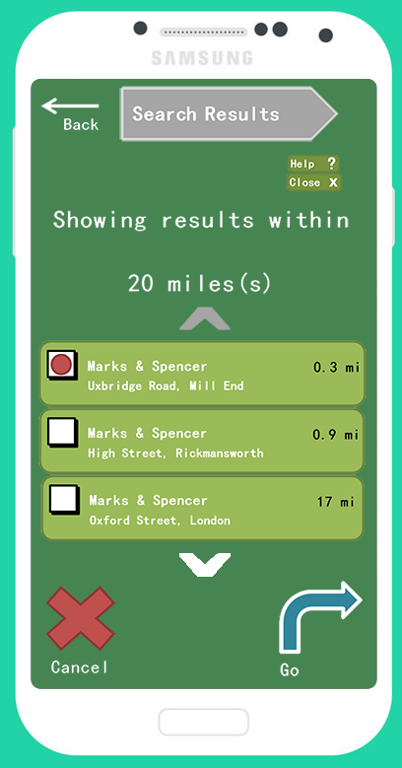
Displaying results
After searching for the selected supermarket(s) and choosing a radius to search for selected supermarkets, the results are displayed with their name, distance and location. You may then select which option you would like and be navigated to your destination, or cancel altogether.

Slide 5
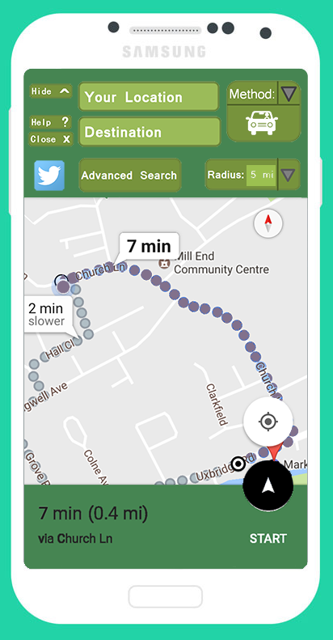
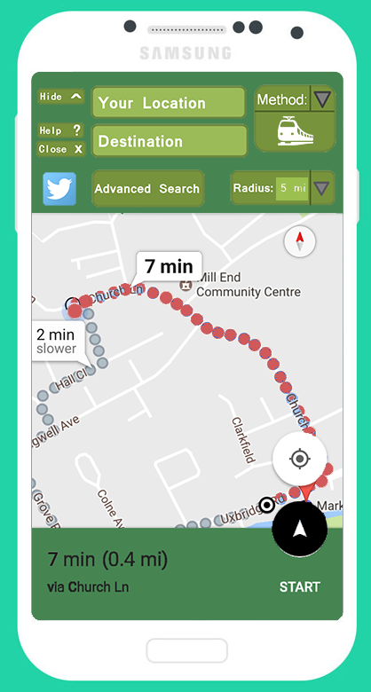
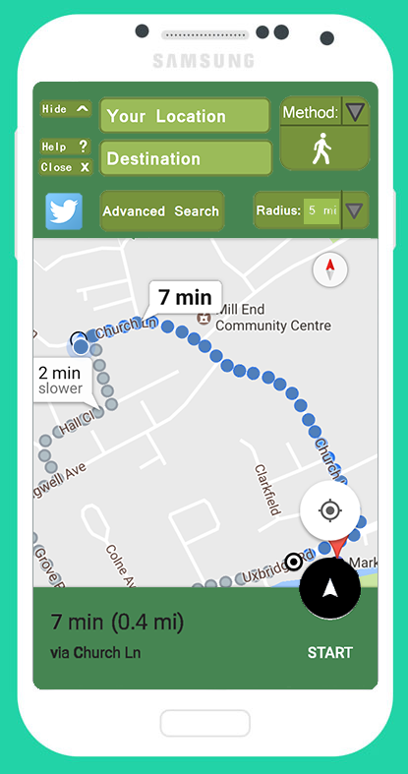
Navigation
When the user decides to select a supermarket to be navigated to, and a method of travel, the app will then display a route to get to the user’s destination. Depending on the method of travel, a different colour route is shown.

Slide 6
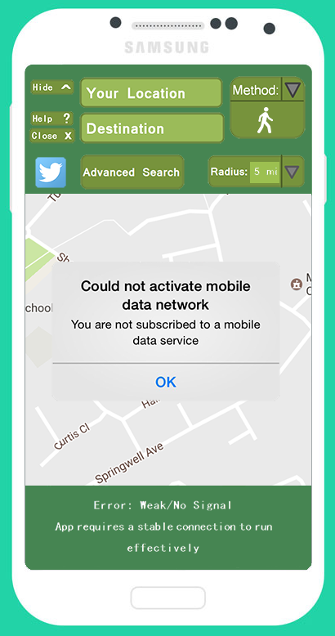
Connection error
In the case that the user does not have mobile data or a weak signal, an error message will be displayed to notify the user.

Slide 7
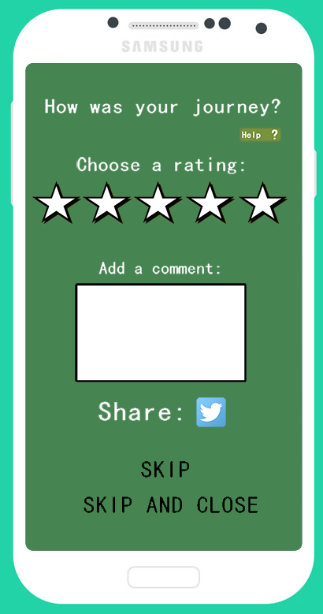
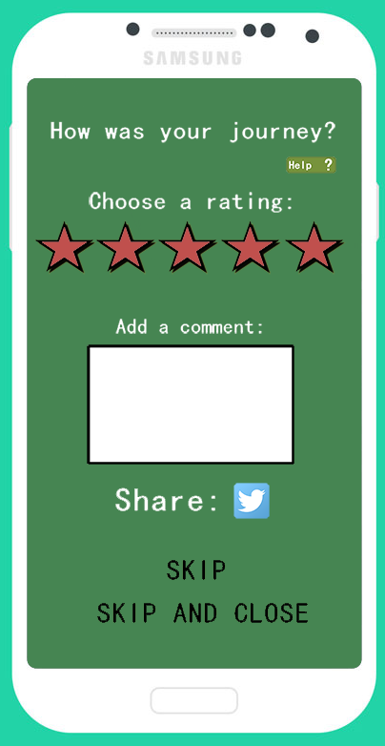
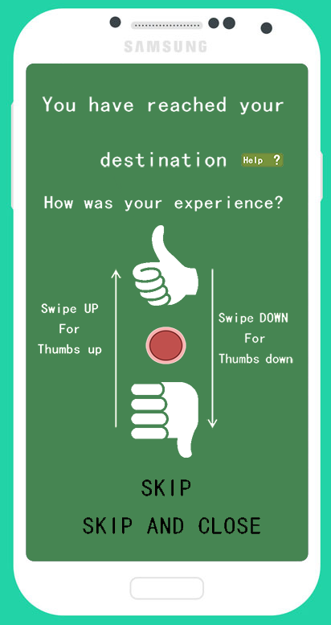
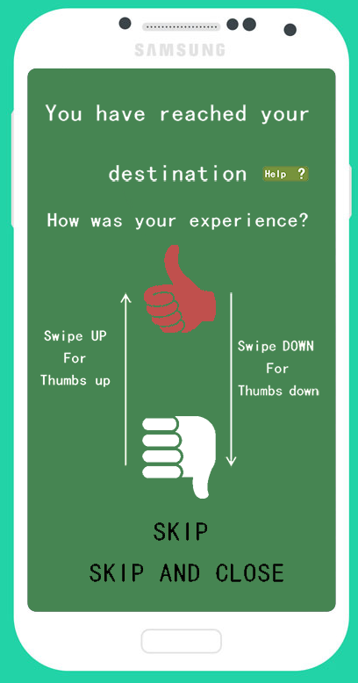
Feedback
In order to make sure users are happy with the app, we’ve decided to implement a feedback system, where a comment may also be written, in order to give ideas for improvement or if there are any bugs. Currently we have two feedback systems to choose from.

